Slide 1
Driver’s rating analysis of f1 2021, f1 22 and f1 23
Rizno Fadhil

Slide 2
process
Data Exploration
Modeling

Slide 3
Data Exploration
F1 2021

Slide 4
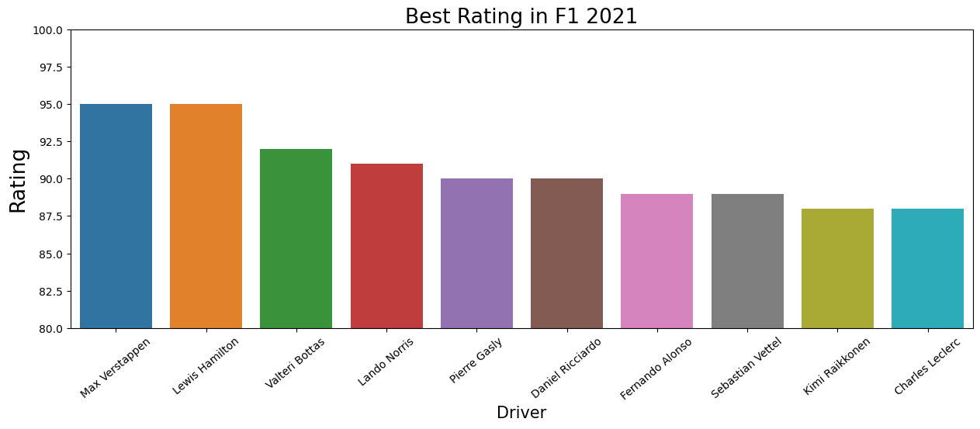
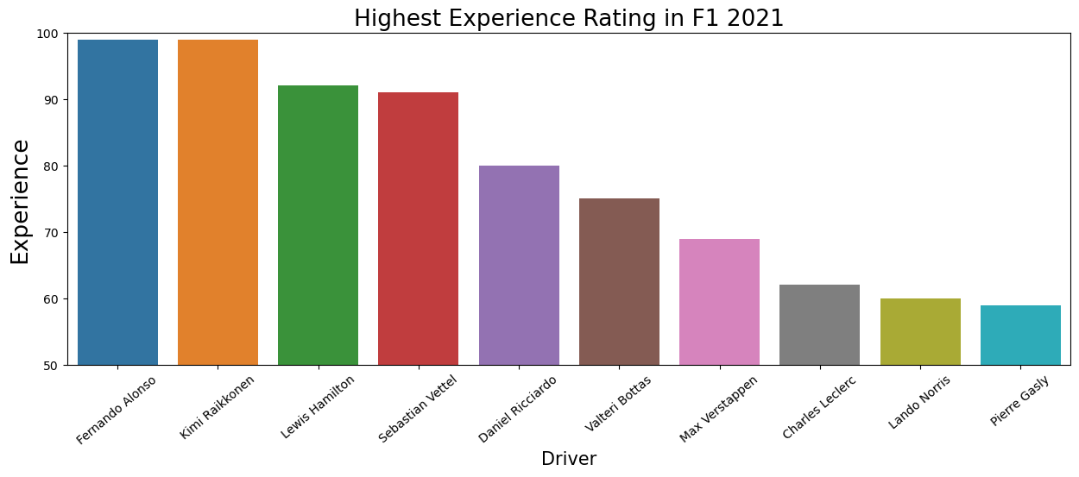

Slide 5
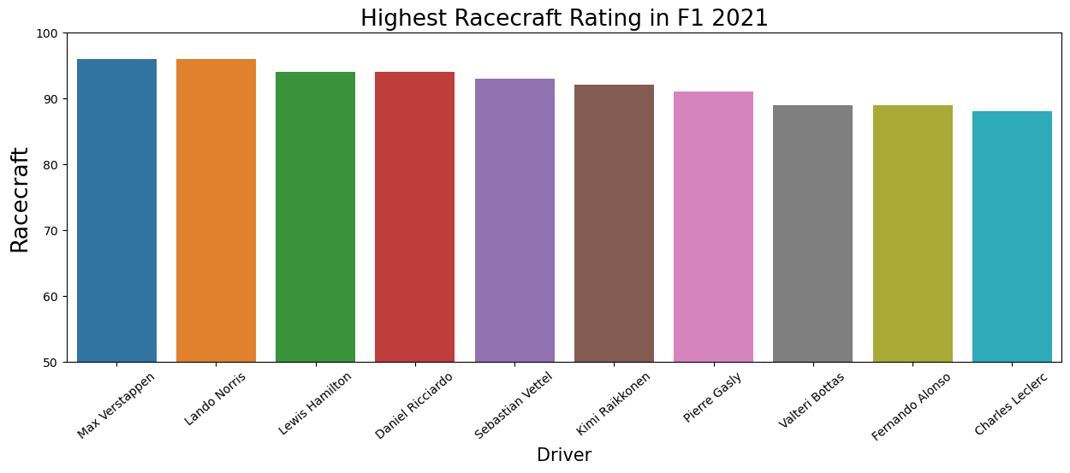
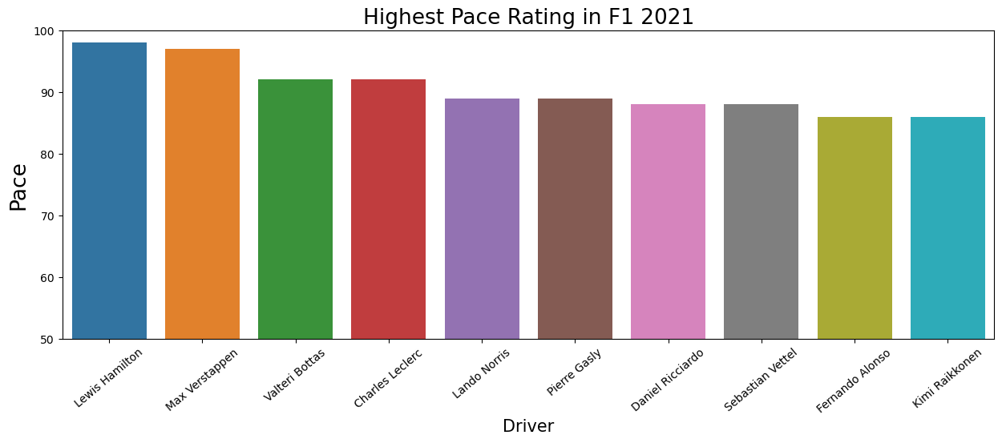
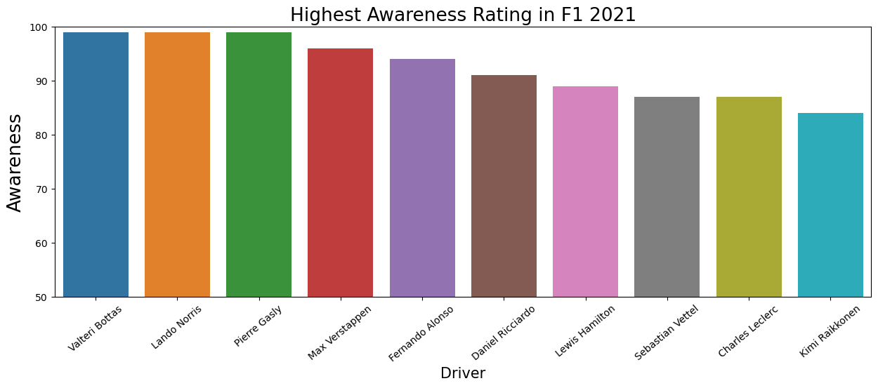

Slide 6
Interesting Notes
Max Verstappen tied with Lewis Hamilton as the Driver with the highest Rating in F1 2021.
Fernando Alonso tied with Kimi Raikkonen as the Driver with the highest Experience in F1 2021.
Max Verstappen tied with Lando Norris as the Driver with the highest Racecraft in F1 2021.
Valteri Bottas tied with Lando Norris and Pierre Gasly as the Driver with the highest Awareness in F1 2021.
Max Verstappen, Lewis Hamilton, and Lando Norris are Top 5 on 4 of 5 Attributes on F1 2021.

Slide 7
Data Exploration
F1 22

Slide 8
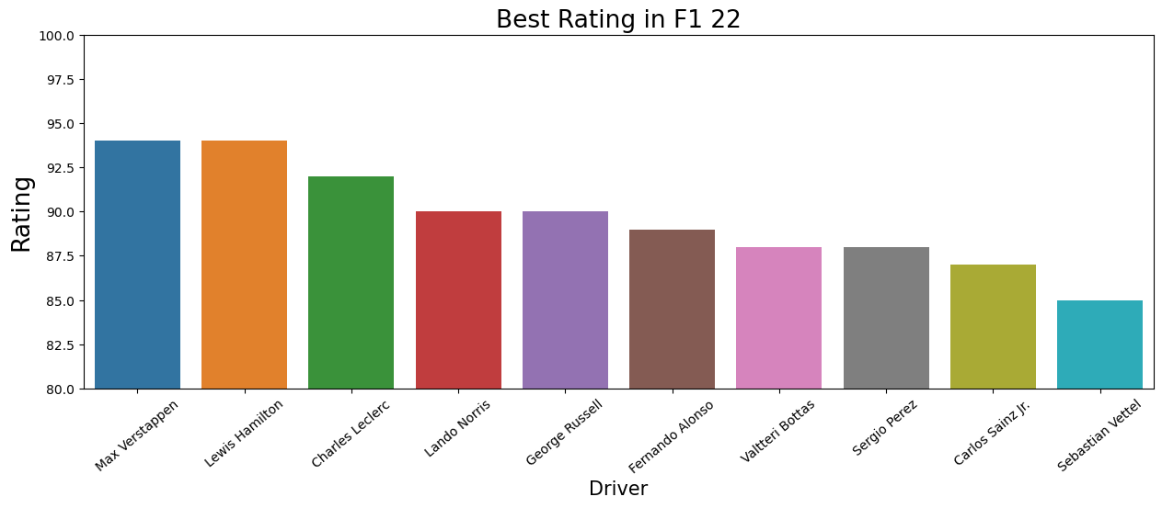
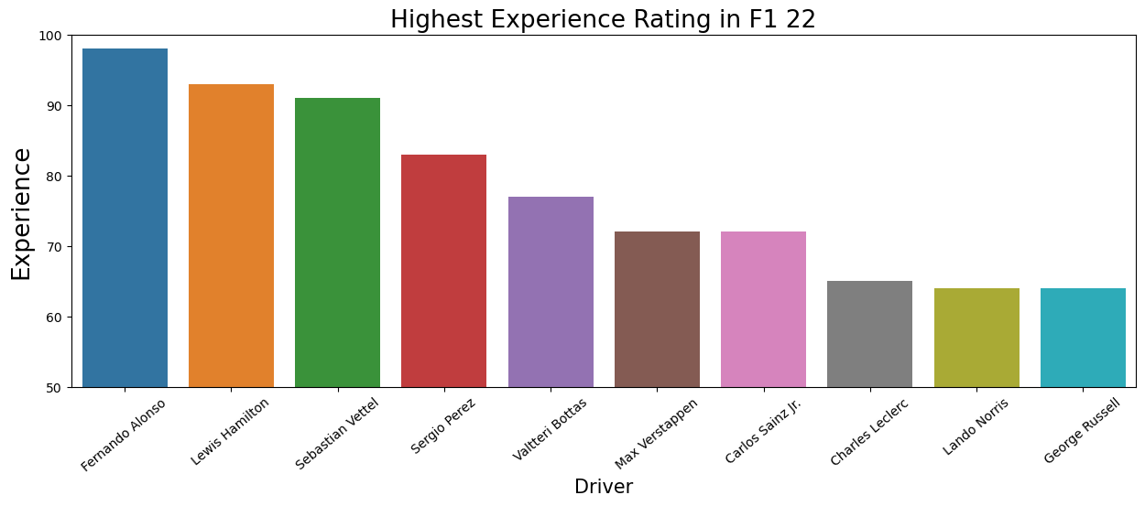

Slide 9
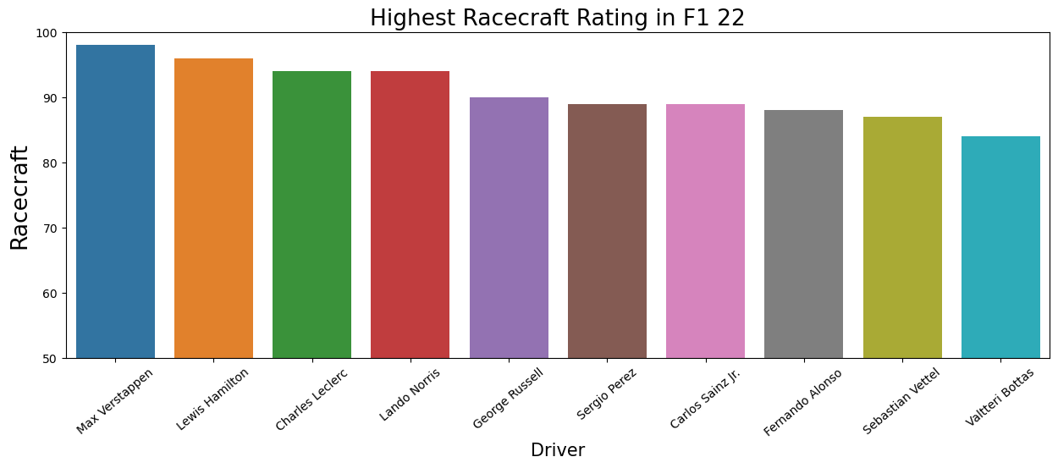
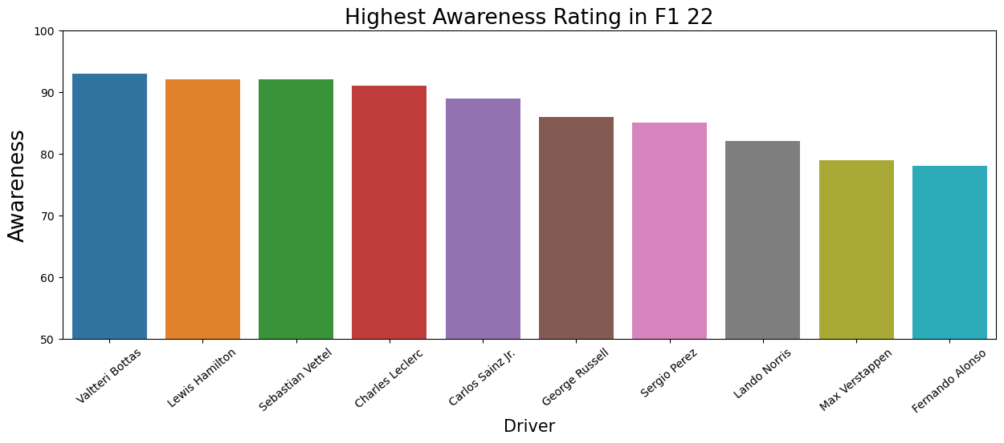
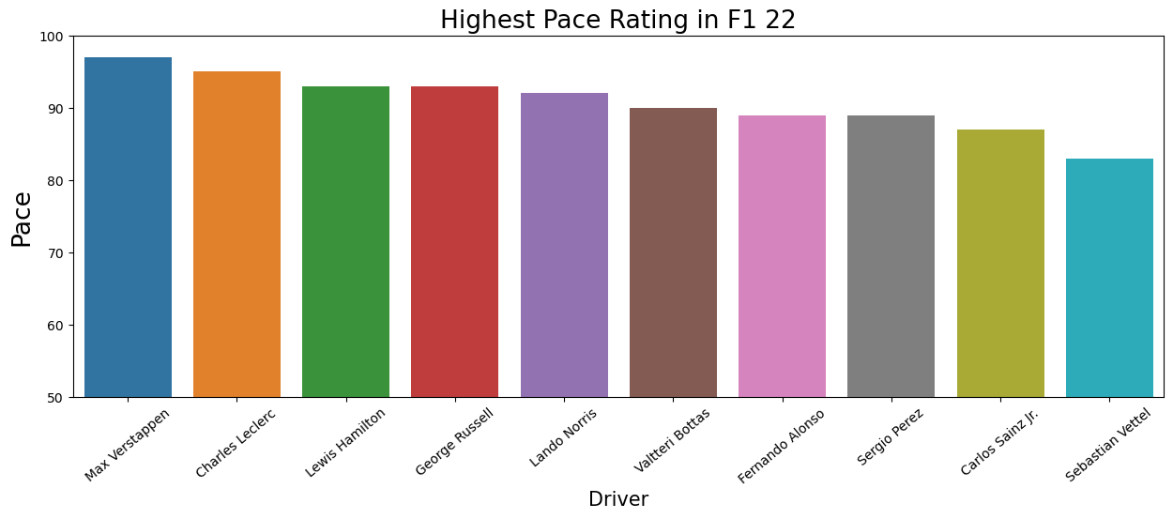

Slide 10
Interesting Notes
Max Verstappen tied with Lewis Hamilton as the Driver with the highest Rating in F1 22.
Fernando Alonso is the Driver with the highest Experience in F1 22.
Max Verstappen is the Driver with the highest Racecraft and Pace in F1 22.
Valteri Bottas is the Driver with the highest Awareness in F1 22.
Lewis Hamilton is the only Driver in Top 5 of all Attributes on F1 22.

Slide 11
Data Exploration
F1 23

Slide 12
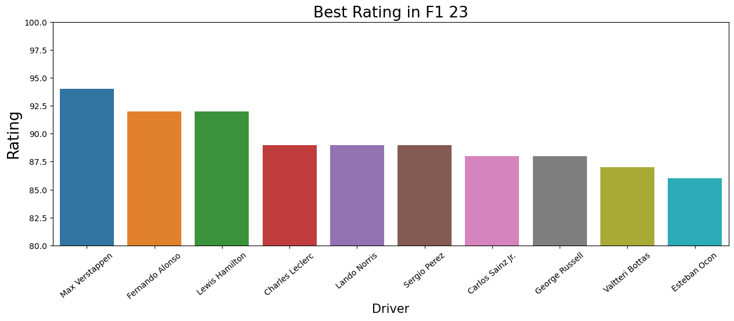
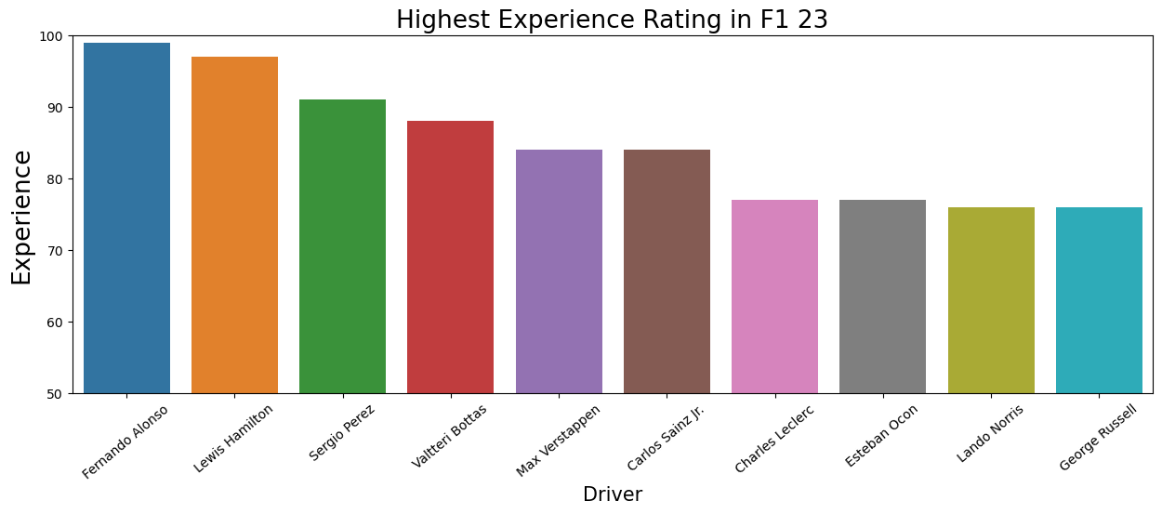

Slide 13
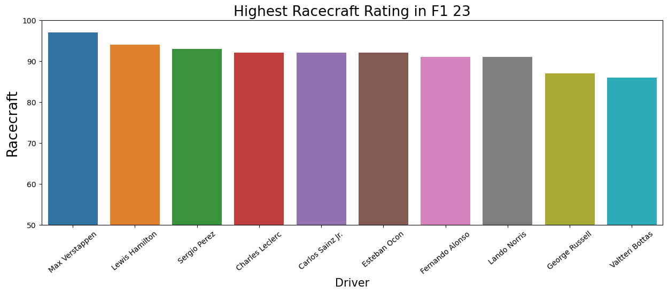
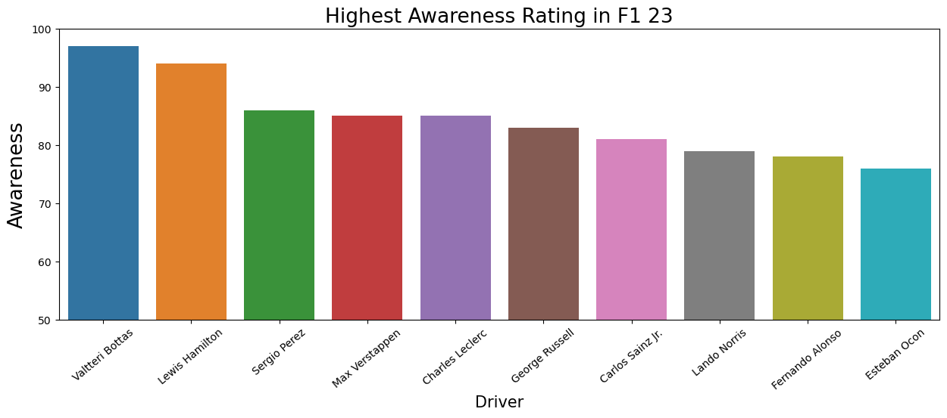
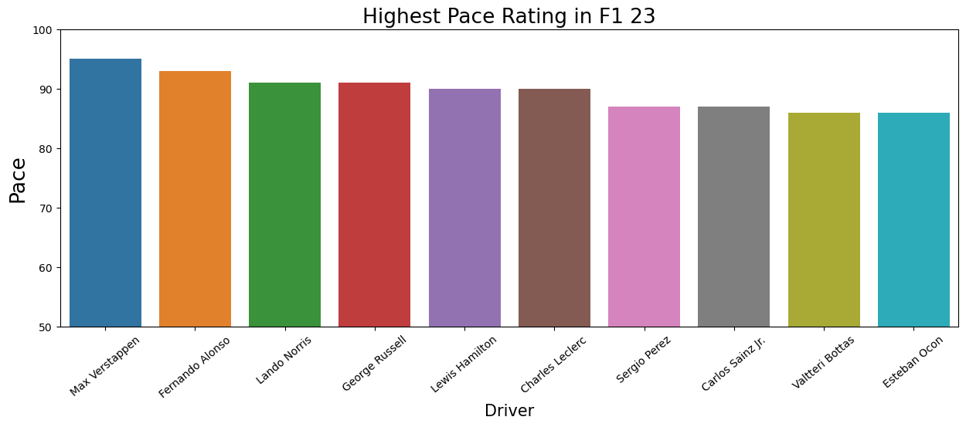

Slide 14
Interesting Notes
Max Verstappen is the Driver with the highest Rating, Racecraft, and Pace in F1 23.
Fernando Alonso is the Driver with the highest Experience in F1 23.
Valteri Bottas is the Driver with the highest Awareness in F1 23.
Max Verstappen and Lewis Hamilton are Top 5 on all Attributes on F1 23.

Slide 15
Data exploration overall notes
Max Verstappen are top 4 on at least 4 Attributes of F1 2021, F1 22, and F1 23.
Lewis Hamilton are top 5 on all Attributes of F1 22 and F1 23.

Slide 16
Modeling

Slide 17
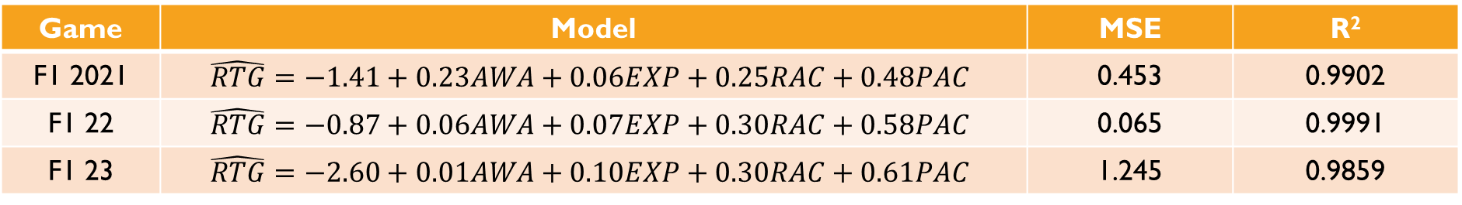
Rating model and evaluation metrics
Game | Model | MSE | R²
F1 2021 | $$\hat{RTG}=−1.41+0.23AWA+0.06EXP+0.25RAC+0.48PAC$$ | 0.453 | 0.9902
F1 22 | $$\hat{RTG}=−0.87+0.06AWA+0.07EXP+0.30RAC+0.58PAC$$ | 0.065 | 0.9991
F1 23 | $$\hat{RTG}=−2.60+0.01AWA+0.10EXP+0.30RAC+0.61PAC$$ | 1.245 | 0.9859

Slide 18
Thank you.

